Slide 1
Python Inheritance
Week 4

Slide 2
Definition
Inheritance allows us to define a class that inherits all the methods and properties from another class.
Parent class is the class being inherited from, also called base class.
Child class is the class that inherits from another class, also called derived class.

Slide 3
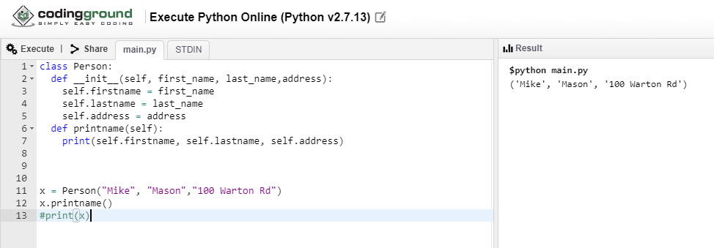
Example:

Slide 4
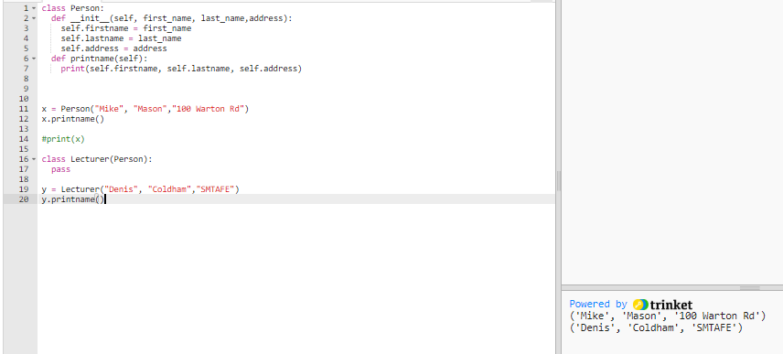
Create a class named Lecturer, which will inherit the properties and methods from the Person class:

